Slide 1

Landslide Detection Using Satellite Imagery
By
Avishek Mondal - 679
Tamal Mallik - 759
Souvik Baidya - 748

Slide 2

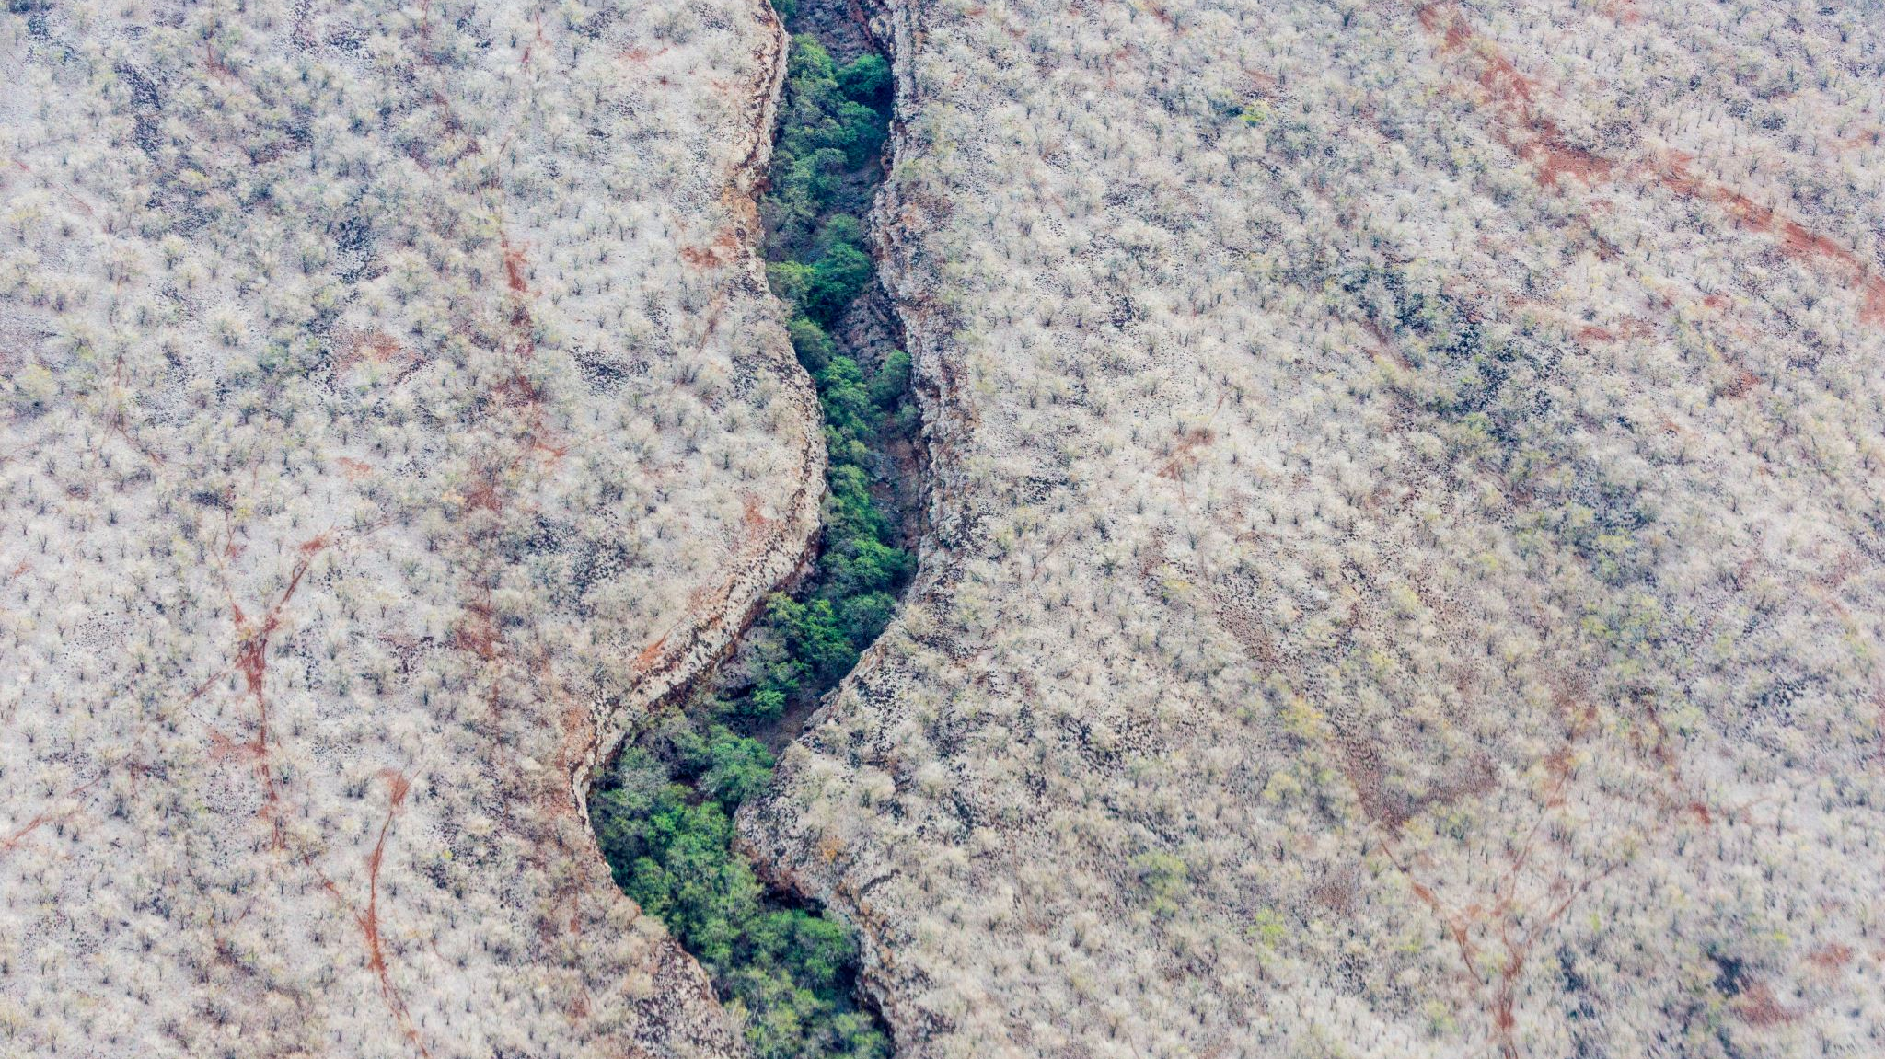
Understanding Landslides: A Global Concern
What Are Landslides?
Definition: Landslides are the movement of rock, earth, or debris down a slope due to gravity.
Types: They can occur as rockfalls, deep failure of slopes, and shallow debris flows.
Recent Devastating Events
Kinnaur, India (August 2021): resulted in at least 13 fatalities.
Maharashtra, India: Monsoon-triggered landslides led to over 136 deaths
Global Impact
Statistics: Between 1998 and 2017, landslides affected 4.8 million people caused over 18,000 fatalities worldwide.
Frequency: On average, thousands of deaths are attributed to landslides each year.

Slide 3
Objective:
Preprocess Satellite image
Extract Features from image
Training Machine Learning model based on given data
Give new Data to recognize if the area prone to landslide or not

Slide 4

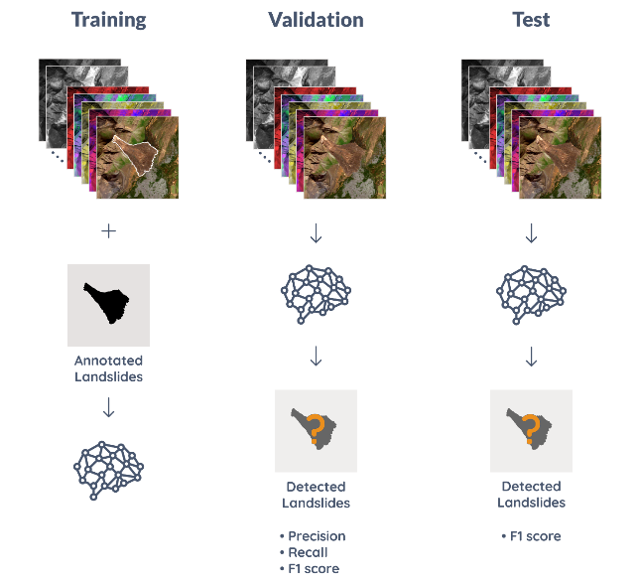
Dataset
Landslide4Sense dataset has three splits
Training 3799
Validation 245
Test 800
Each image patch is a composite of 14 bands that include:
Multispectral data
Slope data
Digital elevation model (DEM)

Slide 5
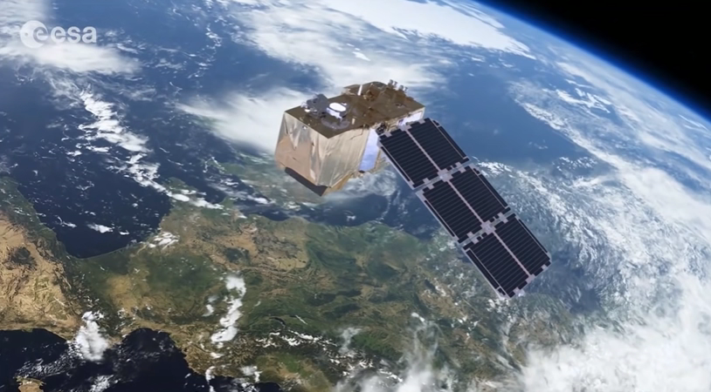

Multispectral data from Sentinel-2: B1, B2, B3, B4, B5, B6, B7, B8, B9, B10, B11, B12
B1: Coastal Aerosol, Ultra Blue, 443 nm¹.
B2: Blue, Blue, 490 nm¹.
B3: Green, Green, 560 nm¹.
B4: Red, Red, 665 nm¹.
B5: Vegetation Red Edge, VNIR, 705 nm¹.
B6: Vegetation Red Edge, VNIR, 740 nm¹.
B7: Vegetation Red Edge, VNIR, 783 nm¹.
B8: NIR, NIR, 842 nm¹.
B8a: Narrow NIR, VNIR, 865 nm¹.
B9: Water Vapor, SWIR, 940 nm¹.
B10: Cirrus, SWIR, 1375 nm¹.
B11: SWIR, SWIR, 1610 nm¹.
B12: SWIR, SWIR, 2190 nm¹.
Multispectral data

Slide 6
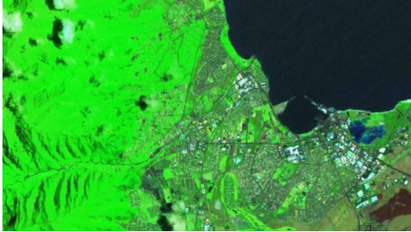
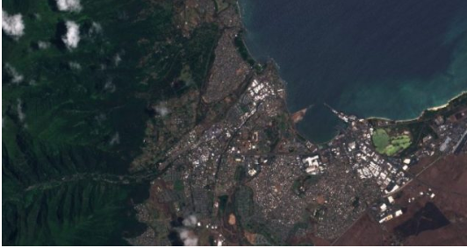
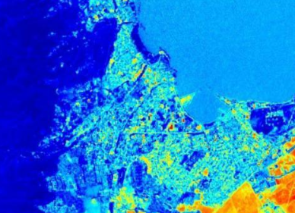
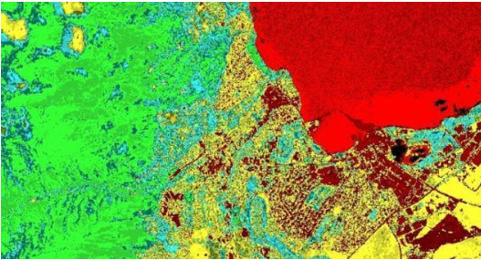
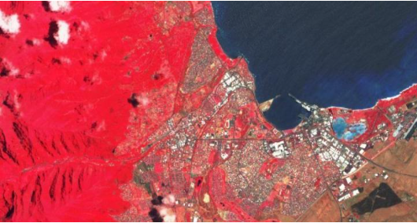
Short-Wave Infrared (B12, B8A, B4)
Natural Color (B4, B3, B2)
Moisture Index
(B8A-B11)/(B8A+B11)
Vegetation Index
VI =(B8-B4)/(B8+B4)
Color Infrared (B8, B4, B3)

Slide 7
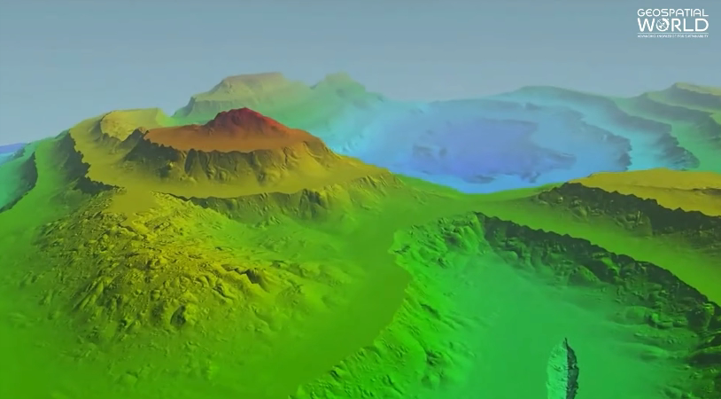
DEM (Digital Elevation Model)
3D representation of a topographic surface
Types of DEMs:
Digital Surface Model (DSM): Represents the Earth’s surface and includes all objects on it.
Digital Terrain Model (DTM): Represents the bare ground surface without any objects like plants and buildings.
Fig :DEM

Slide 8


slope data
Gives information about steepness or gradient
Quantifies the inclination of the terrain, indicating whether it is flat, gently sloping, or steep
In a slope map:
• Flat Areas shown in Gray.
• Gentle Slopes: Represented in green, indicating a slight but noticeable incline.
• Moderate Slopes: shown in yellow or orange.
• Steep Slopes: Typically depicted in red or brown.

Slide 9
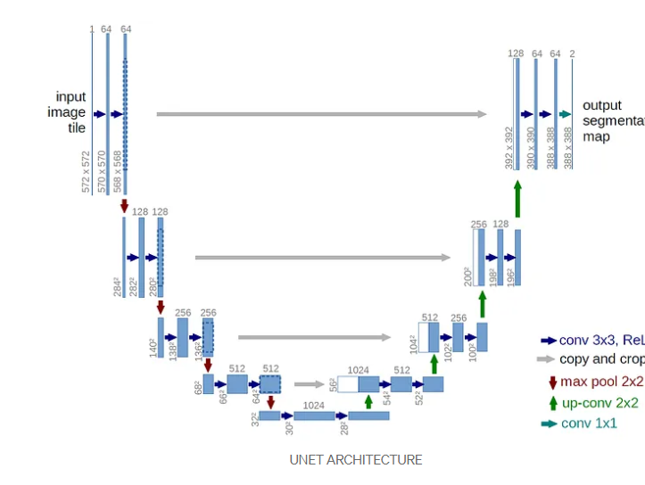
U-Net
CNN architecture for fast and precise segmentation of images.
U-shaped Encoder and Decoder Architecture
Left >> encoder network
Right >> Decoder Network
Skip Connections

Slide 10
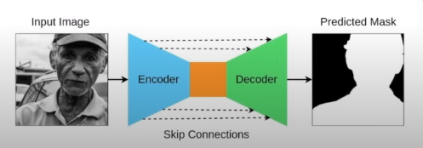

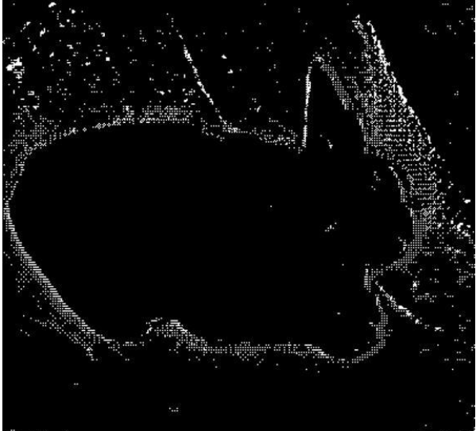
Example
encoder receives the input image
extracts useful features from that image
decoder then up samples the features
we get a segmentation mask

Slide 11
Data Acquisition
Data Preprocessing
Model Definition
Project Workflow Diagram
Model Training
Model Evaluation
Hyperparameter Tuning
Model Testing
Predictions

Slide 12
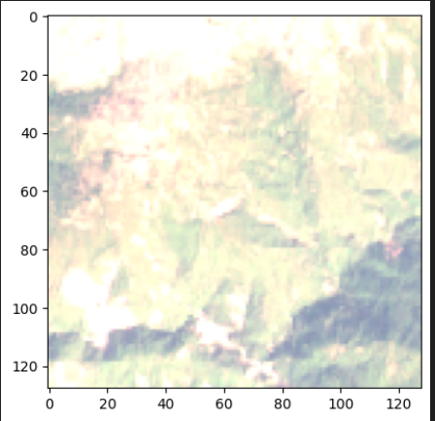
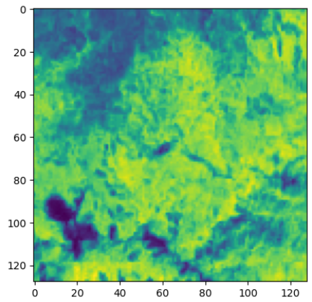
Evaluation:
Normal(RGB) Image to NDVI image:
RGB
NDVI

Slide 13
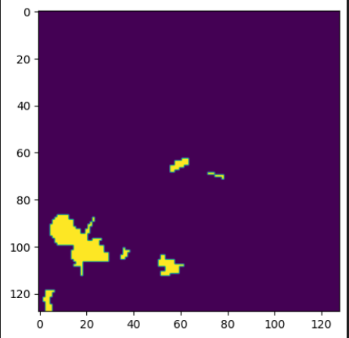
RGB
Labelled Data

Slide 14
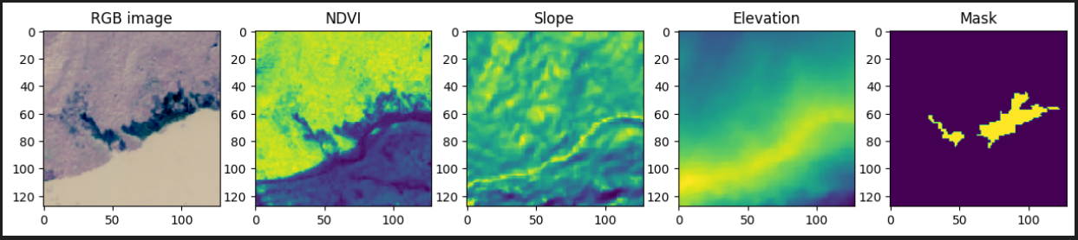
visualization of training data

Slide 15
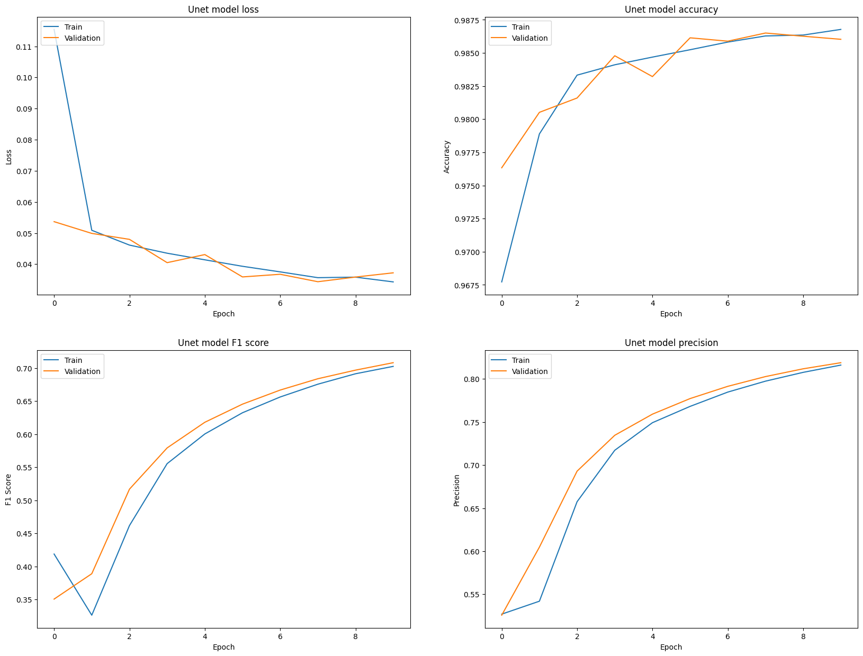
performance metrics of the U-Net model

Slide 16
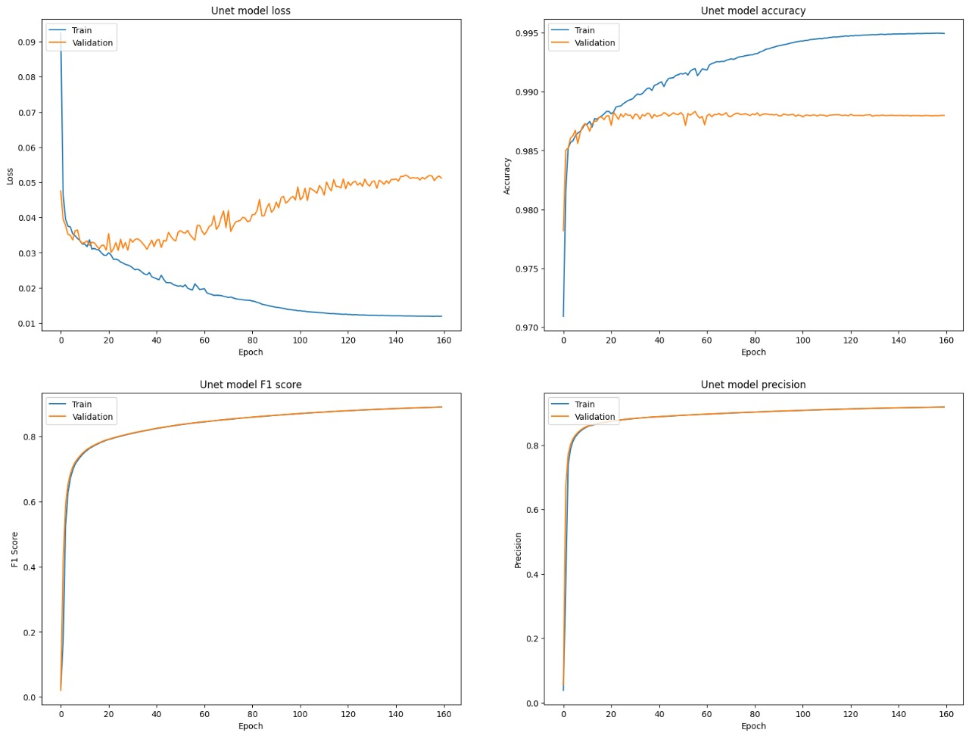

Slide 17
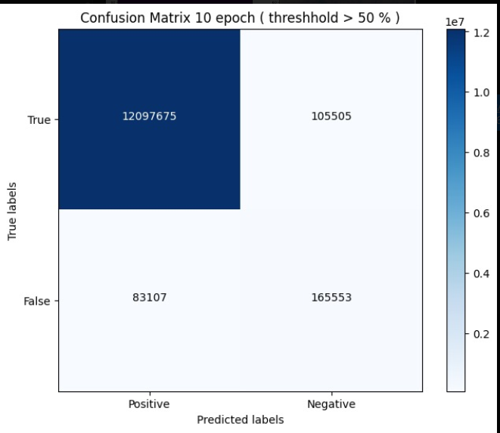


Slide 18
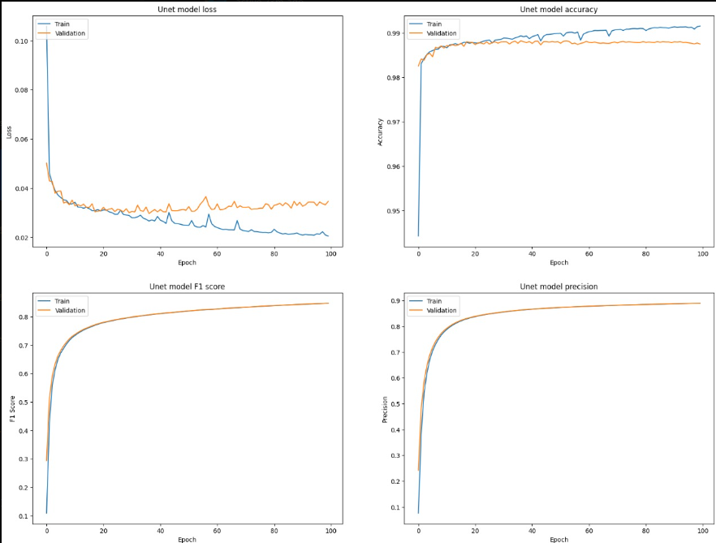

Slide 19
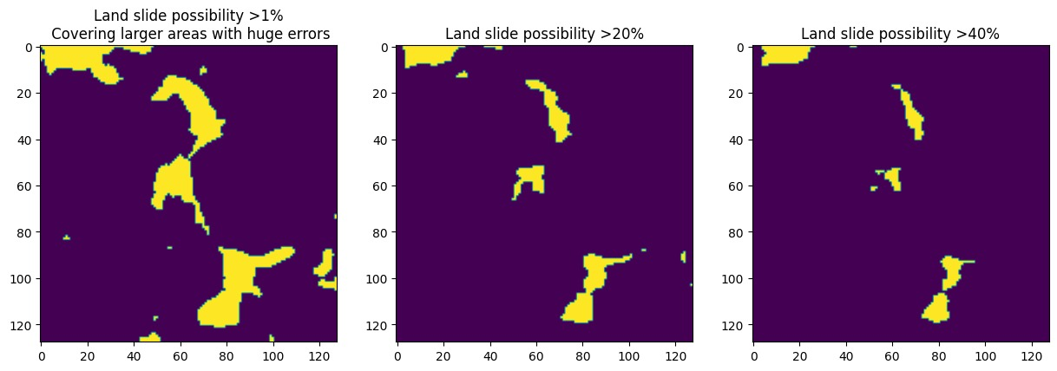
Values with Low precision and High recall

Slide 20
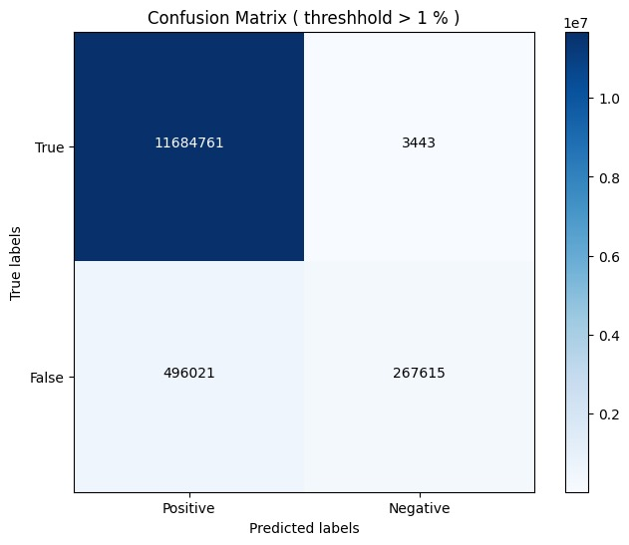

Slide 21
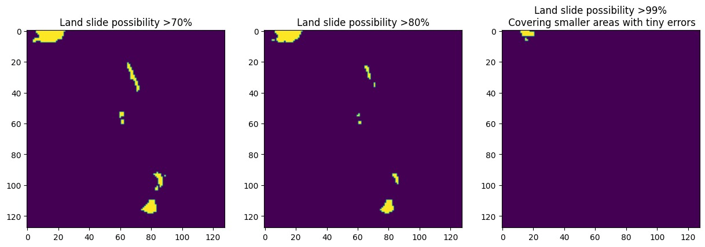
Values with High precision and Low recall

Slide 22


Slide 23
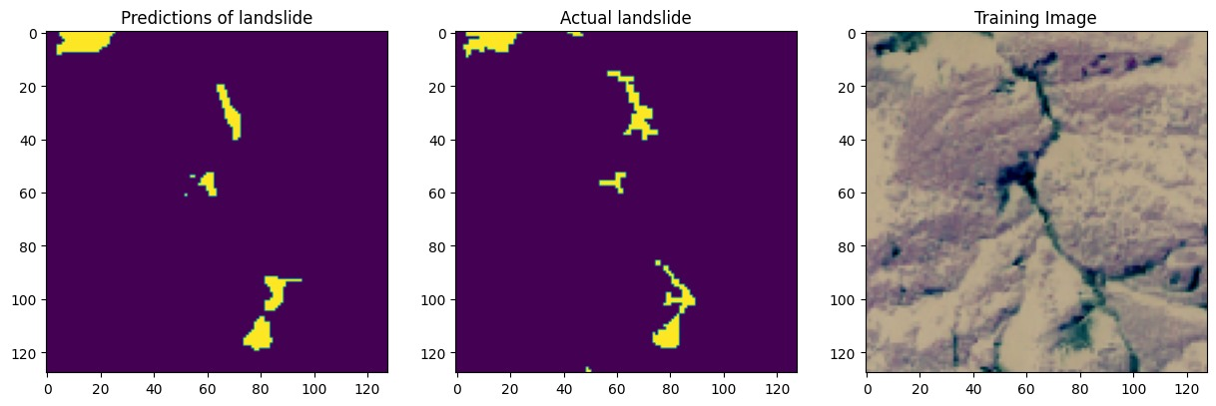

Slide 24


Slide 25
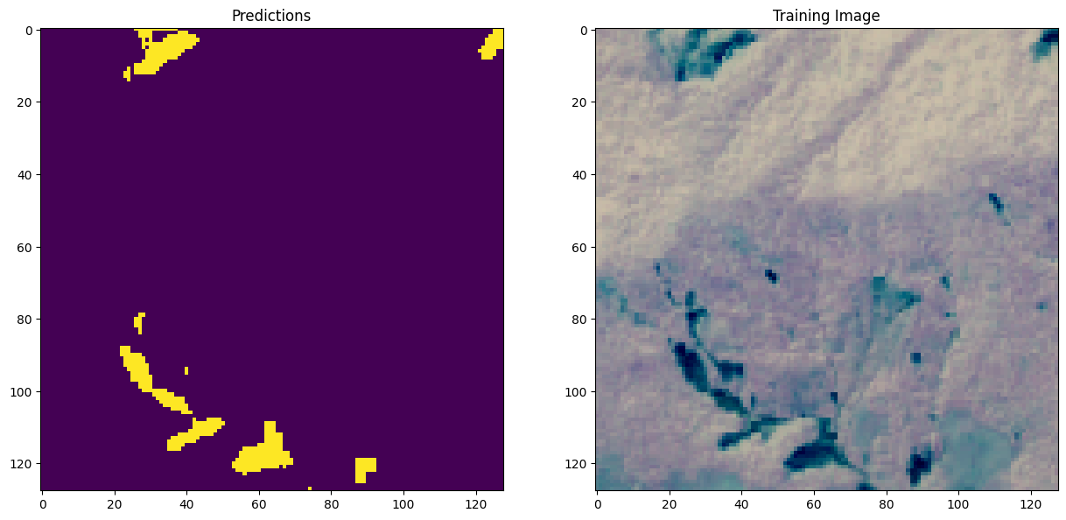
Final Prediction

Slide 26
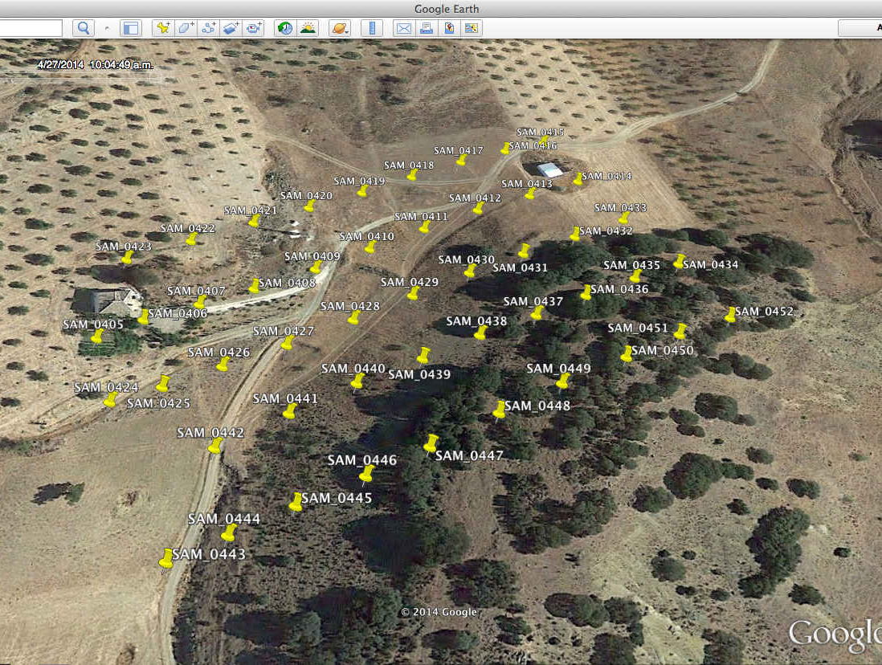
The future scope and application
Improved Accuracy and Efficiency
Integration with Disaster Management Systems
Precision Agriculture and Environmental Monitoring:
Urban Planning and Infrastructure Development
Climate Change Adaptation
This Photo by Unknown Author is licensed under CC BY-SA

Slide 27
Bibliography
Smith, J. (2022). Advances in Satellite Image Analysis for Landslide Detection. Journal of Geospatial Research, 10(2), 45-62.
Brown, A., & Johnson, C. (2023). Deep Learning Approaches for Landslide Detection: A Review. International Conference on Machine Learning and Remote Sensing, Proceedings, 78-85.
Global Landslide Catalog. (2021). Retrieved from https://www.globallandslide.org/
Landslide4Sense Challenge. (2020). Official Website. Retrieved from https://www.landslide4sense.com/
Chen, L., & Wang, Y. (2019). Application of Sentinel-2 Imagery in Landslide Detection: A Case Study in Mountainous Regions. Remote Sensing Letters, 11(5), 312-325.
UNet: Convolutional Networks for Biomedical Image Segmentation. (2015). Retrieved from https://arxiv.org/abs/1505.04597

